Slide 1



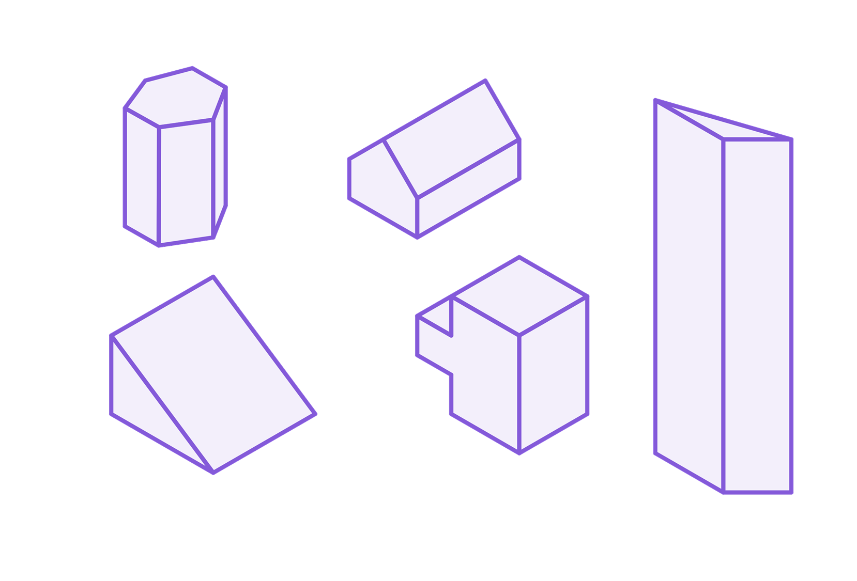
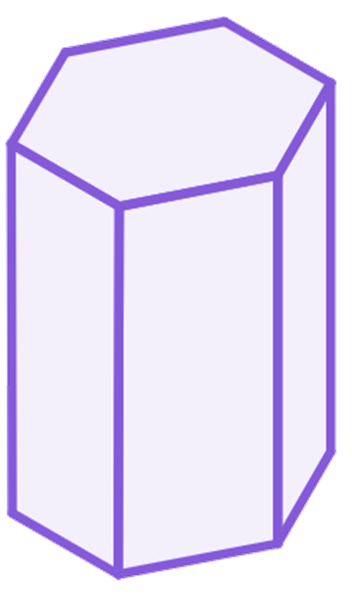
Volume of prisms
Task A: Calculating the volume of any prism
1) Sketch all the cuboids with integer lengths, that have a volume of 18 cm³
2) Calculate the volume of these cuboids
a)
4 cm
b)
2 cm
c)
3.2 m
2 cm
50 mm
3.2 m
3 cm
4 m
1 cm
3) There are pairs of shapes with the same volume. Which shape does not have a pair?
2 cm
1 cm
Area
= 3 cm²
1 cm
2 cm
1 cm
3 cm
1 cm
1 cm
1 cm
4 cm
2 cm
3 cm
2 cm
14 cm
2 cm
3 cm
3 cm
2 cm

Slide 2
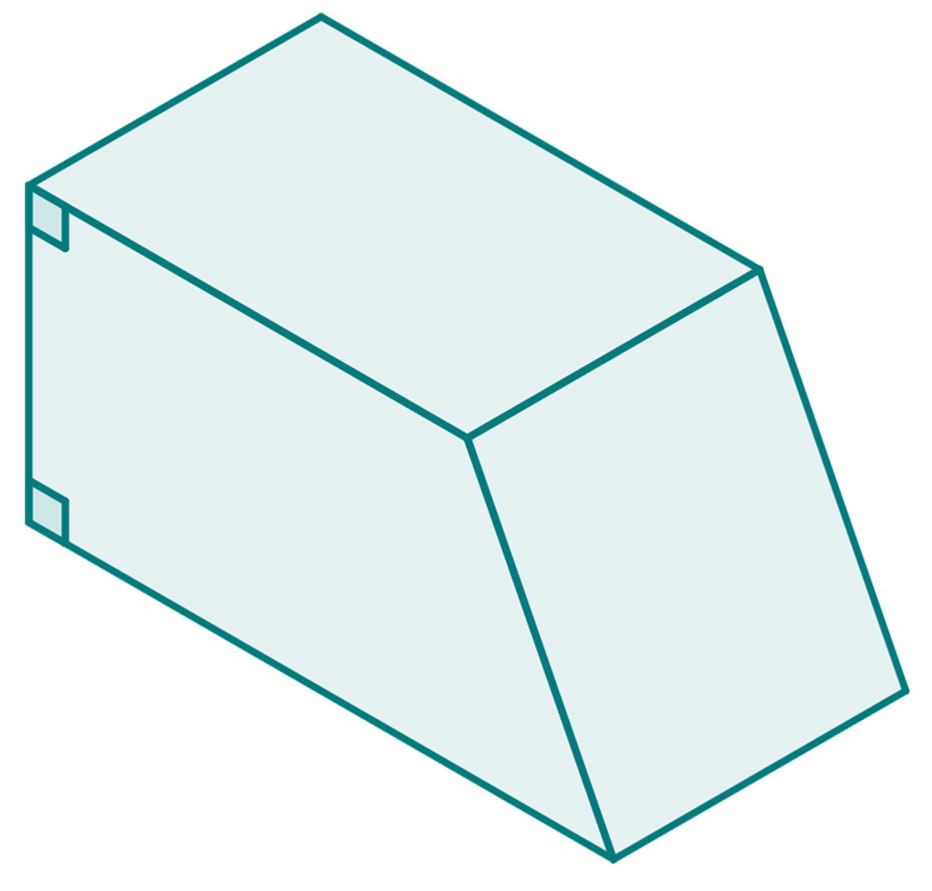

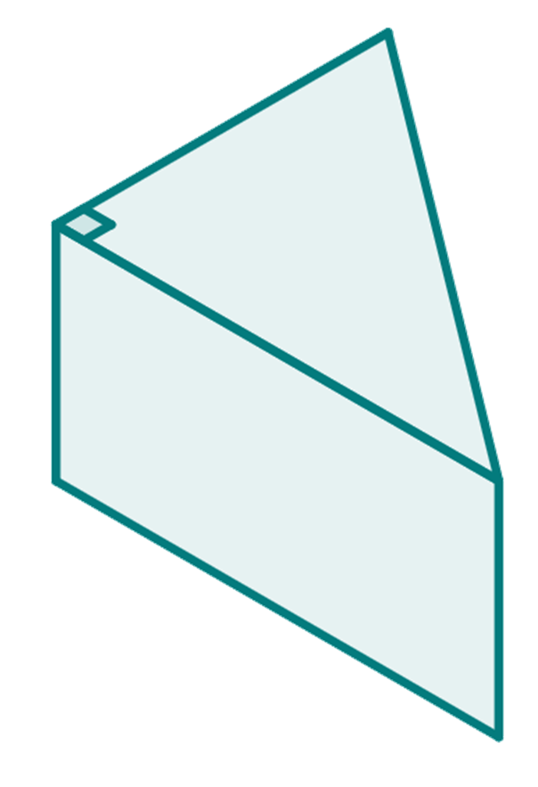
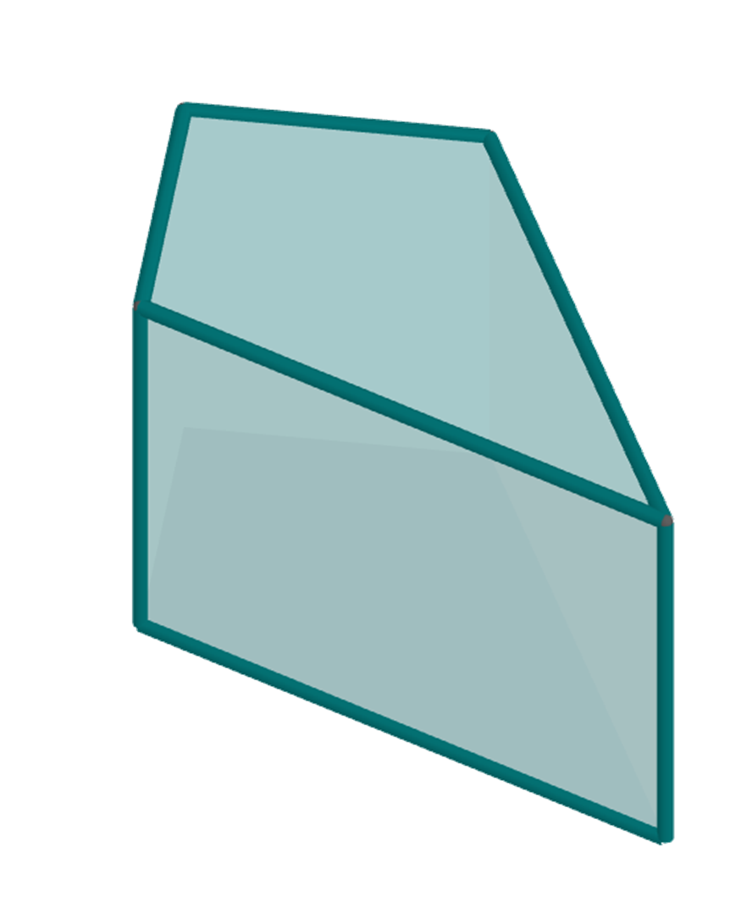


Volume of prisms
Task B: Using the volume of a prism
1) Complete the missing parts of the calculation.
7.5 m
( × (12.5 + ) × x) × 5 = 300
x m
( × × x) × 5 = 300
10x =
12.5 m
x =
5 m
Volume = 300 m³
2) Both prisms have a volume of 378 mm³. Work out the missing length in each prism.
a mm
6 mm
21 mm
7 mm
b mm
12 mm
3) Prism A and prism B have the same volume. Work out the missing length of prism B.
3 cm
12 cm
A
9 cm
B
22 cm
8 cm
4 cm
15 cm
x cm
6 cm
Mathematics in Education and Industry.
v2.2

